Slide 1
Tugas 5
26 Oktober 2024
Ariski Myardi
1103220019
TK-46-04

Slide 2
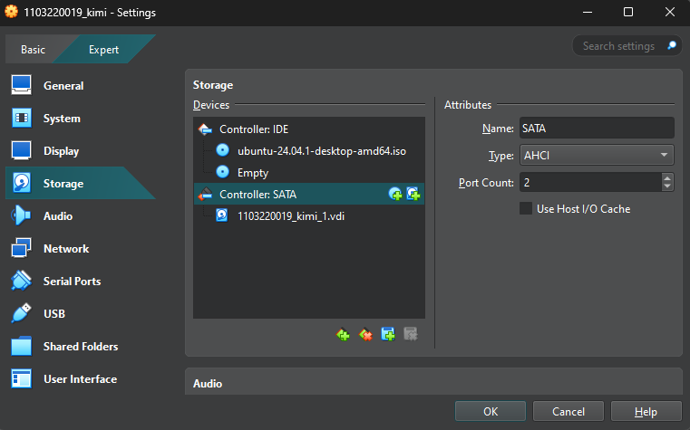
Hands-on 1: Virtual Disk

Slide 3
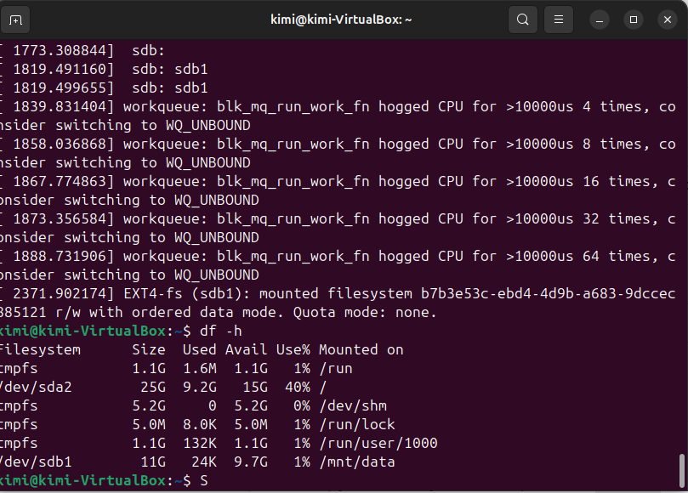
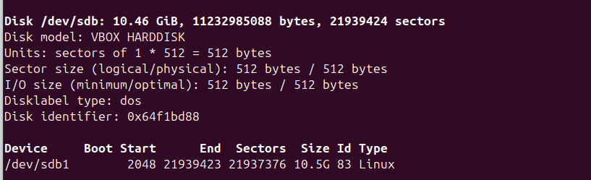
Hands-on 2: Persistent Storage

Slide 4
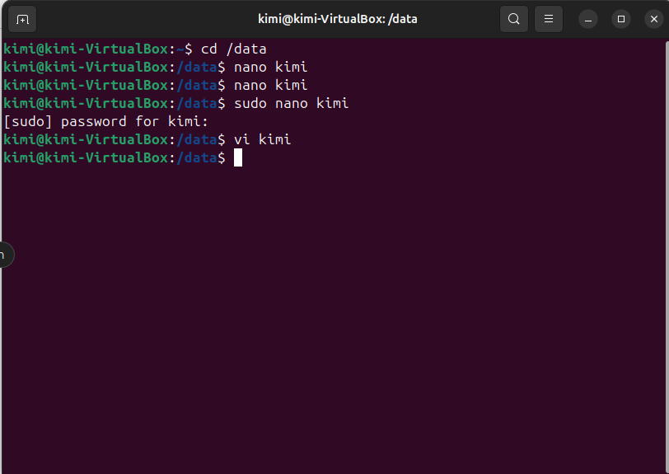
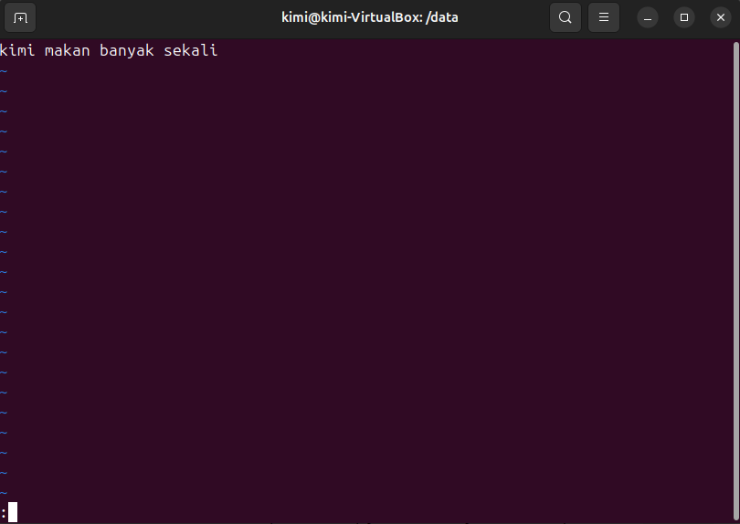
Mounting dan Partisi
Format the new disk (assuming it's /dev/sdb):

Slide 5
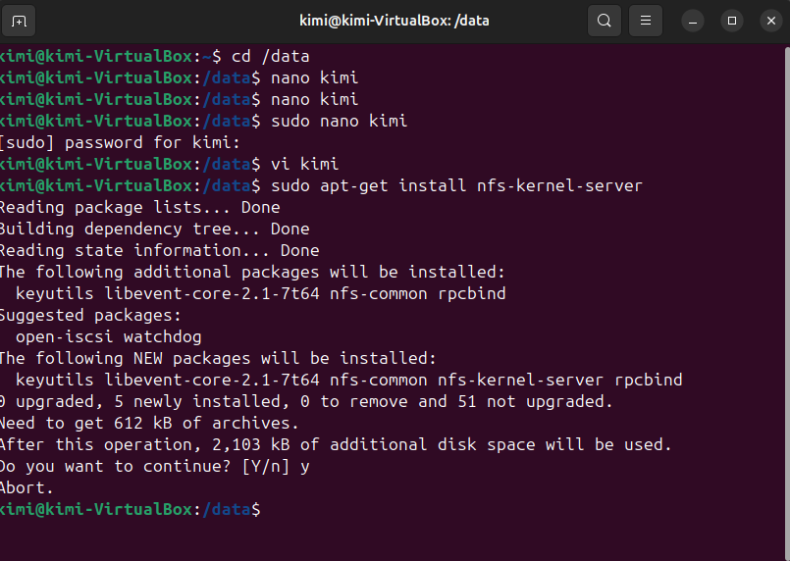
Hands-on 3: Accessing Remote Storage
Menggunakan NFS

Slide 6
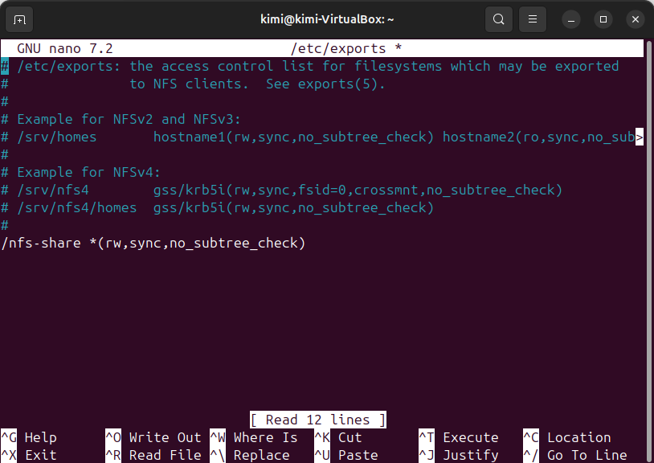
Hands-on 3: Accessing Remote Storage
Tambahkan

Slide 7
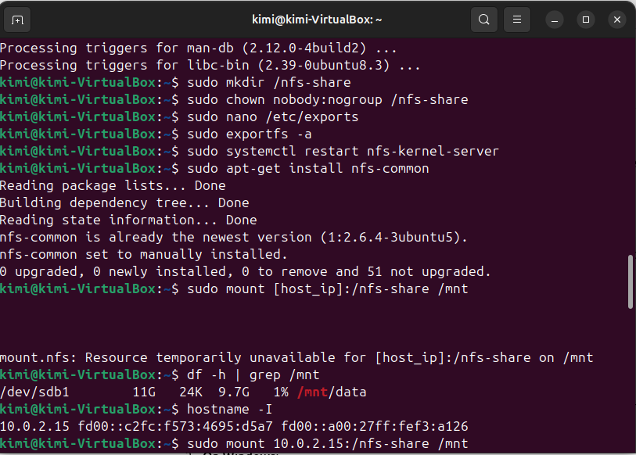
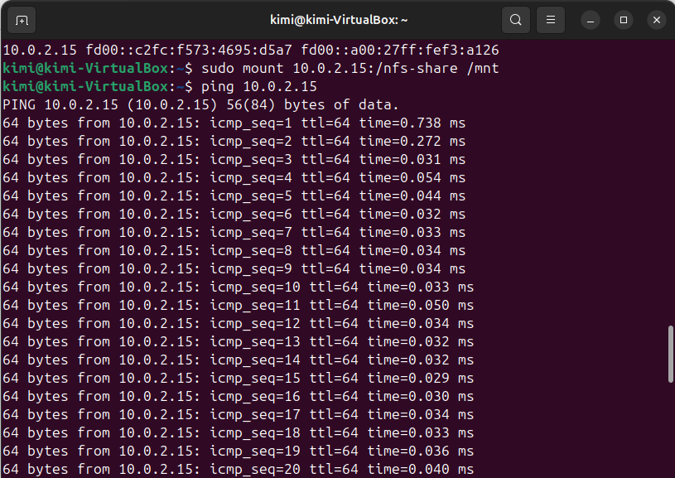
Hands-on 3: Accessing Remote Storage
Mengakses dari Client

